Slide 1

Digital Banking and Talent Shortage in Central Asia
Exploring digital banking's role amidst talent shortages in Central Asia: investment insights, economic impact, and strategic opportunities.
AI-Generated Presentation • Confidential

Slide 2
Executive Summary
1
2
3
4
5
Digital Banking
Talent Shortage
Investment
Growth
Challenges
85% of transactions are cashless in Kazakhstan and Uzbekistan
Insufficient educational outputs and high attrition rates
$11.67 billion invested in digital banking in Central Asia
90.6% growth in digital banking users in Kazakhstan and Uzbekistan
Regulatory frameworks and talent shortages hinder growth
2

Slide 3
Digital Banking
1
Led by Kazakhstan and Uzbekistan with super-app ecosystems
Introduction to Digital Banking in Central Asia
Growth Drivers
2
Increasing internet and mobile penetration, and government support
Challenges
3
Talent shortages and regulatory frameworks
Opportunities
4
Investment in digital banking infrastructure and talent development
Future Outlook
5
Increasing adoption of digital banking services
3

Slide 4
Investment Landscape Analysis
TOTAL INVESTMENT
GROWTH RATE
MARKET SIZE
USER BASE
$11.67 billion
90.6%
$2 billion
4.3 billion
invested in digital banking in Central Asia
growth in digital banking users in Kazakhstan and Uzbekistan
size of the digital banking market in Kazakhstan
number of digital banking users in Uzbekistan
4

Slide 5

Kazakhstan
1
Leading digital banking market with 85% cashless transactions
Country-Specific Digital Banking Assessment
Uzbekistan
2
Growing digital banking market with 90.6% growth in users
Kyrgyzstan
3
Emerging digital banking market with increasing internet penetration
Tajikistan
4
Developing digital banking market with government support
Challenges
5
Talent shortages and regulatory frameworks
5

Slide 6
Internet and Mobile Penetration in Central Asia
COUNTRY
INTERNET PENETRATION (%)
MOBILE CONNECTIONS (% OF POPULATION)
Kazakhstan
92.9
128.0
Uzbekistan
89.0
92.2
2 records · 3 metrics · Source: Document Analysis
6

Slide 7
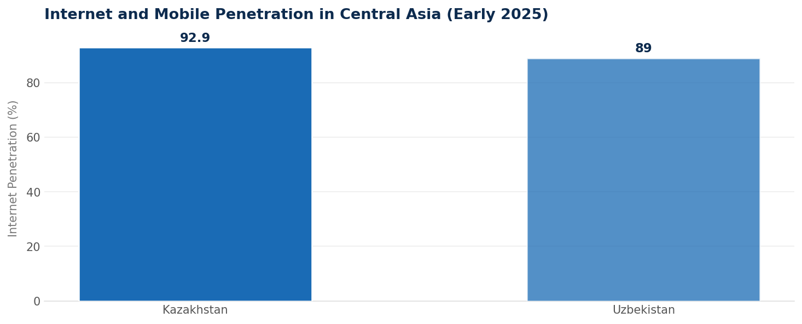
Internet and Mobile Penetration in Central Asia
Data visualization from document analysis
📊
7

Slide 8

Talent Shortage
1
Insufficient educational outputs and high attrition rates
Talent Shortage: Current State Analysis
Skills Gap
2
Lack of skills in fintech, AI, and digital banking
Brain Drain
3
Migration-driven brain drain affecting talent pool
Challenges
4
Talent shortages hindering growth of digital banking
Opportunities
5
Investment in talent development and education
8

Slide 9
Strategic Recommendations for Investors
01
02
03
04
05
Invest in Talent Development
Invest in Digital Infrastructure
Partner with Local Players
Focus on Emerging Markets
Monitor Regulatory Frameworks
Develop skills in fintech, AI, and digital banking
Develop digital banking infrastructure
Partner with local banks and fintechs
Focus on emerging markets in Central Asia
Monitor regulatory frameworks and adjustments
9

Slide 10

Education and Training
1
Develop skills in fintech, AI, and digital banking
Talent Development Solutions
Partnerships
2
Partner with local universities and training institutions
Mentorship Programs
3
Develop mentorship programs for young professionals
Internships
4
Offer internships to students and young professionals
Scholarships
5
Offer scholarships to students pursuing degrees in fintech, AI, and digital banking
10

Slide 11

Future Outlook and Projections
Digital banking market to reach $7.3 billion by 2025
85% of transactions to be cashless
90.6% growth in digital banking users
4.3 billion digital banking users
11

Slide 12

Digital Banking Infrastructure
1
Develop digital banking infrastructure
Technology Infrastructure Assessment
Cybersecurity
2
Ensure cybersecurity measures are in place
Data Analytics
3
Develop data analytics capabilities
Cloud Computing
4
Adopt cloud computing technologies
Artificial Intelligence
5
Adopt AI technologies
12

Slide 13

Conclusion
→
Digital banking is growing rapidly in Central Asia
→
Talent shortages and regulatory frameworks are challenges
→
Investment in talent development and digital infrastructure is necessary
→
Partnerships with local players are crucial
→
Monitoring regulatory frameworks is essential
13

